Slide 1

Database 420-231-VA
Vanier College

Slide 2
Introduction
Good decisions require good information derived from raw facts
These raw facts or information must be stored to get accessed for future use
File systems and database came to existence to help organizing, storing, processing, and retrieving data efficiently
Databases evolved from computer file systems

Slide 3
Data vs. Information
Data are raw facts
Information is the result of processing raw data to reveal meaning
Information requires context to reveal meaning
Raw data must be formatted for storage, processing, and presentation
Data are the foundation of information, which is the bedrock of knowledge

Slide 4
Data vs. Information (cont’d.)
Data: building blocks of information
Information produced by processing data
Information used to reveal meaning in data
Accurate, relevant, timely information is the key to good decision making
Good decision making is the key to organizational survival
Data management: focuses on proper generation, storage, and retrieval of data

Slide 5
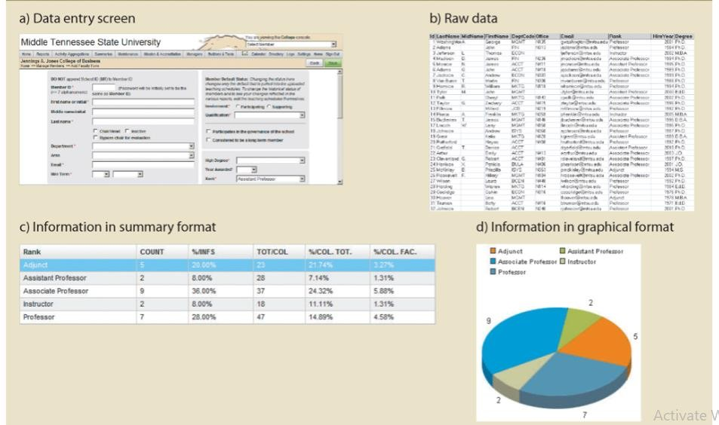
Data vs. Information

Slide 6
Why Databases?
Databases solve many of the problems encountered in data management
  Databases are used in almost all modern settings involving data management:
    Business
    Research
    Administration

Slide 7
Introducing the Database
Database: shared, integrated computer structure that stores a collection of related data being managed by a Database Management System (DBMS).
Data can be:
  - End-user data: raw facts of interest to end user.
  - Metadata: data about data (shows characteristics and relationships in data).
Database management system (DBMS): collection of programs that manage structure and control access to data.
Database System (DBS): It is a combination of a DBMS and a database.
(Note the distinction between DB, DBS, and DBMS)
Popular DBMS Software: MS Access, MS SQL Server, MySQL, Oracle, PostgreSQL, dBASE, FoxPro, SQLite, etc.

Slide 8
Role and Advantages of the DBMS
DBMS is the intermediary between the user and the database
  Database structure is stored as file collection
  We can only access files through the DBMS
DBMS enables data to be shared
DBMS presents the end user (or application program) with an integrated view of data in the database

Slide 9
Role and Advantages of the DBMS
DBMS receives all application requests and translates them into the complex operations required to fulfill those requests.
DBMS hides much of the database’s internal complexity from the application programs and users.
The application program might be written by a programmer using a programming language, or it might be created through a DBMS utility program.

Slide 10
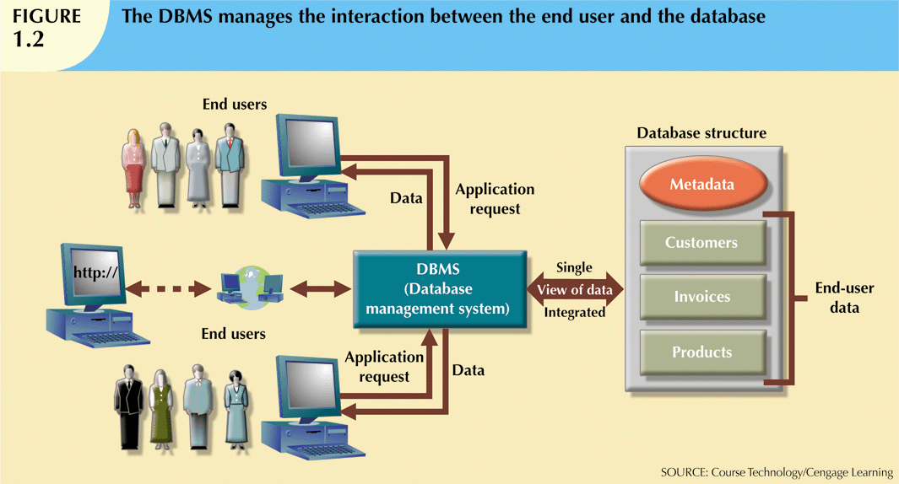

Slide 11
Role and Advantages of the DBMS
Advantages of a DBMS:
  Improved data sharing
  Improved data security
  Better data integration
  Minimized data inconsistency
  Improved data access
  Improved decision making
  Increased end-user productivity

Slide 12
Types of Databases
Databases can be classified according to:
  Number of users
  Database location(s)
  Expected type and extent of use
Single-user database supports only one user at a time
  Desktop database: single-user; runs on PC
Multiuser database supports multiple users at the same time
  Workgroup and enterprise databases

Slide 13
Types of Databases (cont’d.)
Centralized database: data located at a single site
Distributed database: data distributed across several different sites
Operational database: supports a company’s day-to-day operations
  Transactional or production database
Data warehouse: stores data used for tactical or strategic decisions

Slide 14
Types of Databases (cont'd.)
Unstructured data exist in their original state
Structured data result from formatting
  Structure applied based on type of processing to be performed
Semistructured data have been processed to some extent
Extensible Markup Language (XML) represents data elements in textual format
  XML database supports semistructured XML data

Slide 15
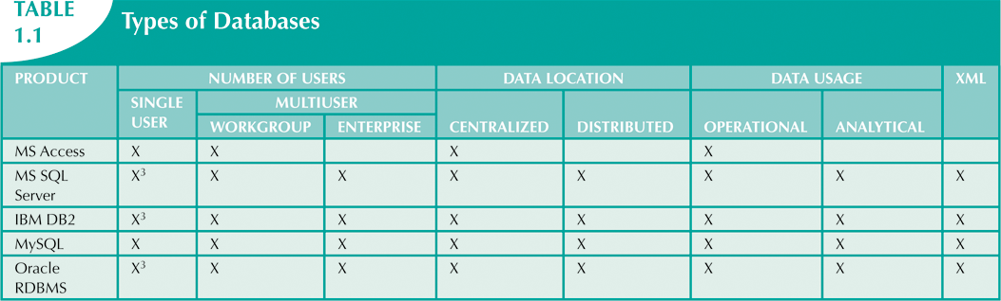

Slide 16
Why Database Design Is Important
Database design focuses on design of database structure used for end-user data
  Designer must identify database’s expected use
Well-designed database:
  Facilitates data management
  Generates accurate and valuable information
Poorly designed database:
  Causes difficult-to-trace errors

Slide 17
Traditional File Systems
In traditional or manual approach, before the computer invention, all information was stored in physical files.
This was accomplished through a system of file folders and filing cabinets; however, as organizations grew and reporting requirements became more complex, keeping track of data in a manual file system became more difficult.
After the invention of computers, the data were stored in the form of electronic files.

Slide 18
Evolution of File System Data Processing
Manual file systems
  Served as a data repository for small data collections
  Cumbersome for large collections
Computerized file systems
  Data processing (DP) specialist converted computer file structure from manual system
    Wrote software that managed the data
    Designed the application programs

Slide 19
Evolution of File System Data Processing (cont'd.)
Initially, computer file systems resembled manual systems
As number of files increased, file systems evolved. With file systems:
  Each file used its own application program to store, retrieve, and modify data
  Each file was owned by individual or department that commissioned its creation

Slide 20
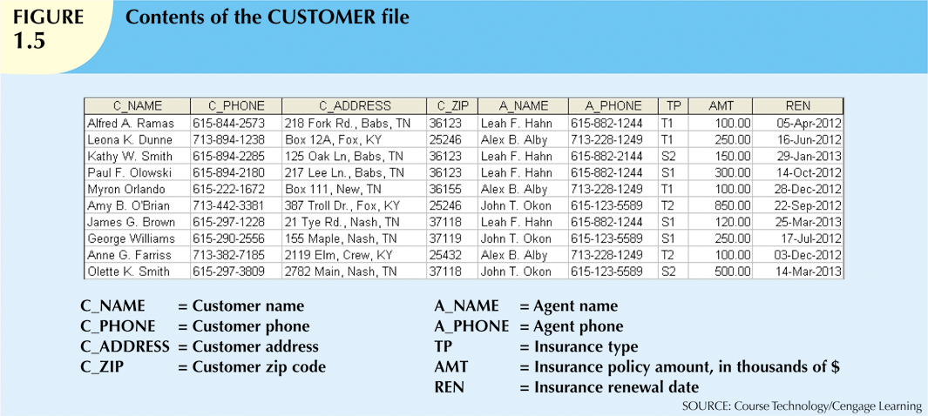

Slide 21
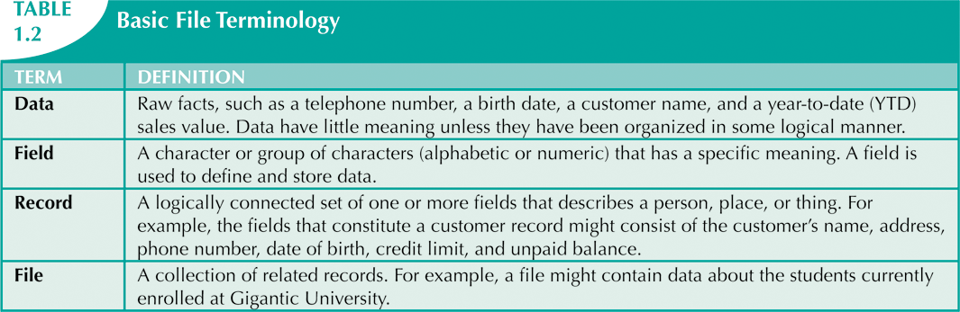

Slide 22
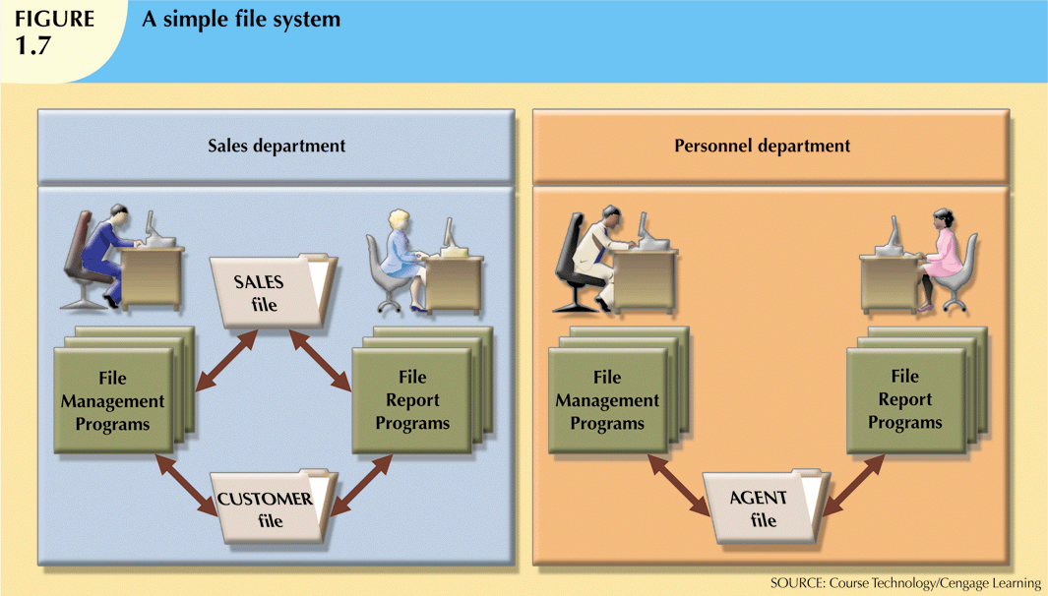

Slide 23
Problems with File System Data Processing
Security features difficult to program
Requires extensive programming
Cannot perform ad hoc queries
System administration is complex and difficult
Difficult to make changes to existing structures
Security features are likely to be inadequate

Slide 24
Limitations of File-Based Approach
Separation and isolation of data
  Each program maintains its own set of data.
  Users of one program may be unaware of potentially useful data held by other programs.
Duplication of data
  Same data is held by different programs.
  Wasted space and potentially different values and/or different formats for the same item.
Incompatible file formats
  Programs are written in different languages, and so cannot easily access each other’s files.
Fixed Queries of application programs
  Programs are written to satisfy particular functions.
  Any new requirement needs a new program to produce even the simplest reports.

Slide 25
Data Redundancy
File system structure makes it difficult to combine data from multiple sources
  Vulnerable to security breaches
Organizational structure promotes storage of same data in different locations
  Islands of information
Data stored in different locations is unlikely to be updated consistently
Data redundancy: same data stored unnecessarily in different places

Slide 26
Data Redundancy (cont'd.)
Data inconsistency: different and conflicting versions of same data occur at different places
Data anomalies: abnormalities when all changes in redundant data are not made correctly
  Update anomalies
  Insertion anomalies
  Deletion anomalies

Slide 27
Database Systems
Database system consists of logically related data stored in a single logical data repository
  May be physically distributed among multiple storage facilities
  DBMS eliminates most of file system’s problems
  Current generation stores data structures, relationships between structures, and access paths
    Also defines, stores, and manages all access paths and components

Slide 28
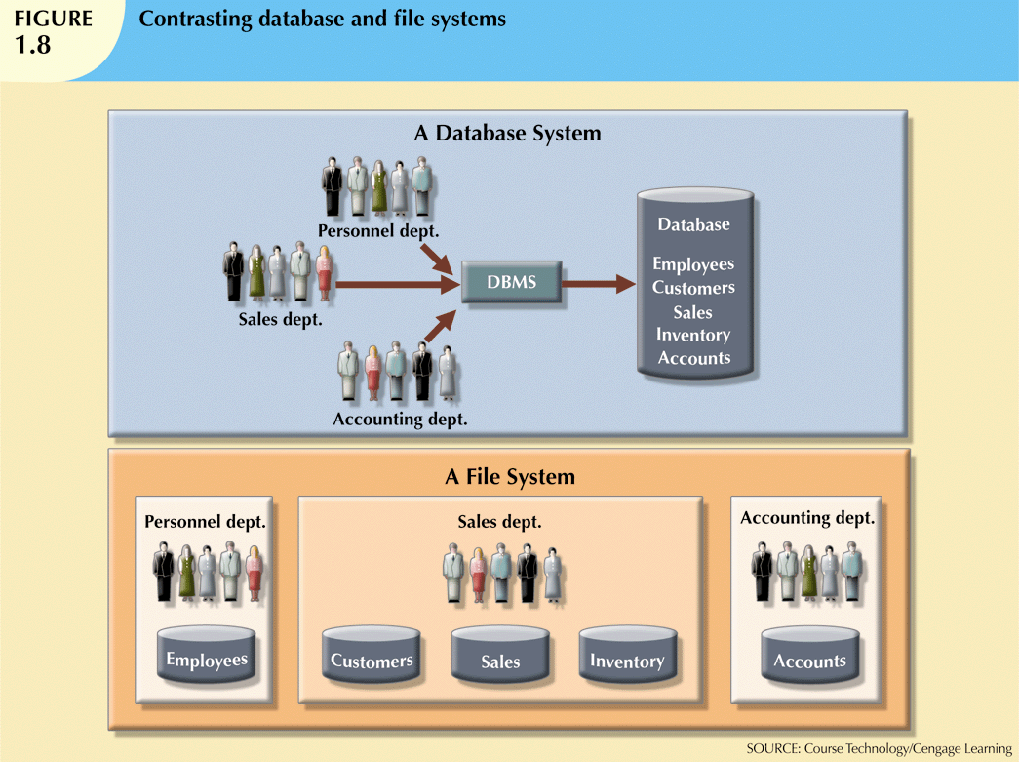

Slide 29
The Database System Environment
Database system: defines and regulates the collection, storage, management, use of data
Five major parts of a database system:
  Hardware
  Software
  People
  Procedures
  Data

Slide 30
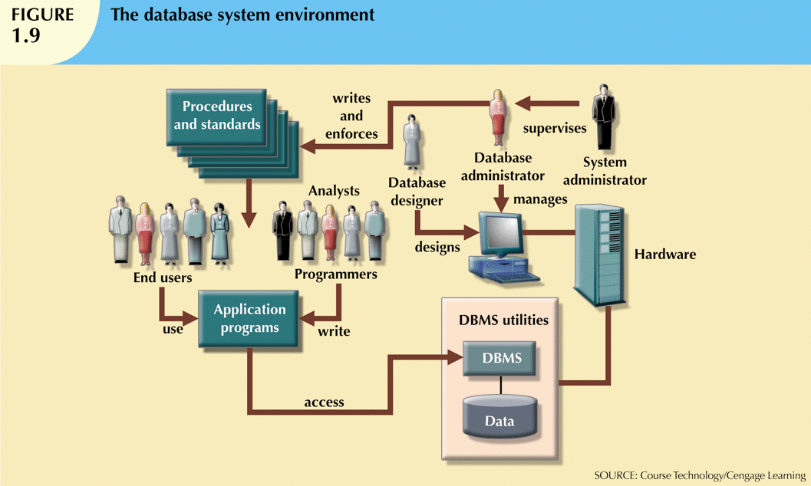

Slide 31
The Database System Environment (cont'd.)
Hardware: all the system’s physical devices
Software: three types of software required
  Operating system software
  DBMS software
  Application programs and utility software

Slide 32
The Database System Environment (cont'd.)
People: all users of the database system
  System and database administrators
  Database designers
  Systems analysts and programmers
  End users
Procedures: instructions and rules that govern the design and use of the database system
Data: the collection of facts stored in the database

Slide 33
DBMS Functions
Most functions are transparent to end users:
Data dictionary management
  DBMS stores definitions of data elements and relationships (metadata) in a data dictionary
  Changes automatically recorded in the dictionary

Slide 34
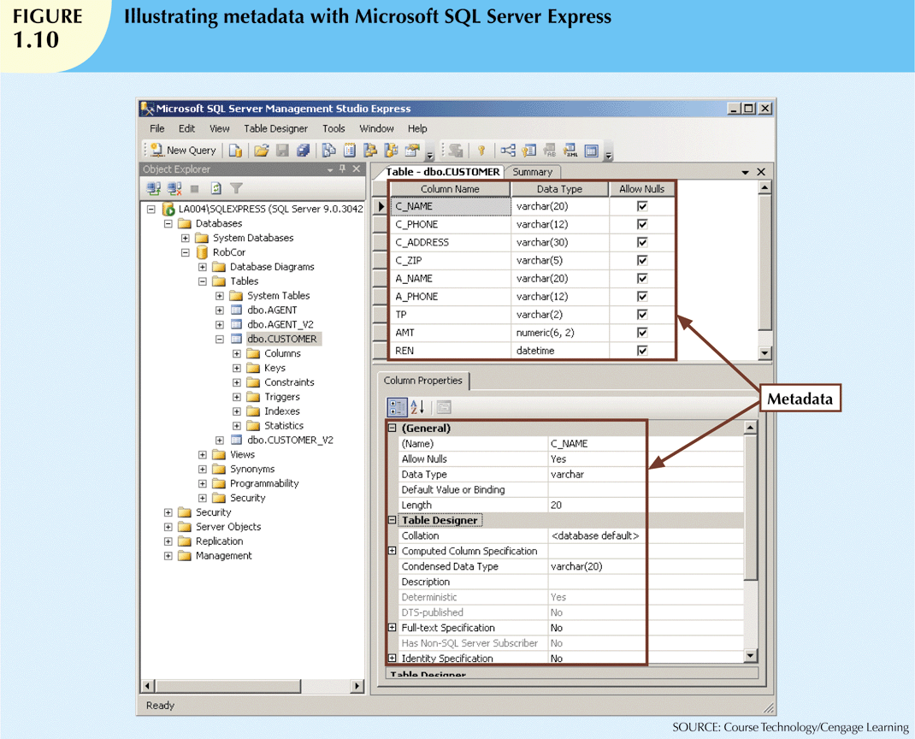

Slide 35
DBMS Functions (cont'd.)
Data storage management
  DBMS creates and manages complex structures required for data storage
  Also stores related data entry forms, screen definitions, report definitions, etc.
  Performance tuning: activities that make the database perform more efficiently
  DBMS stores the database in multiple physical data files

Slide 36
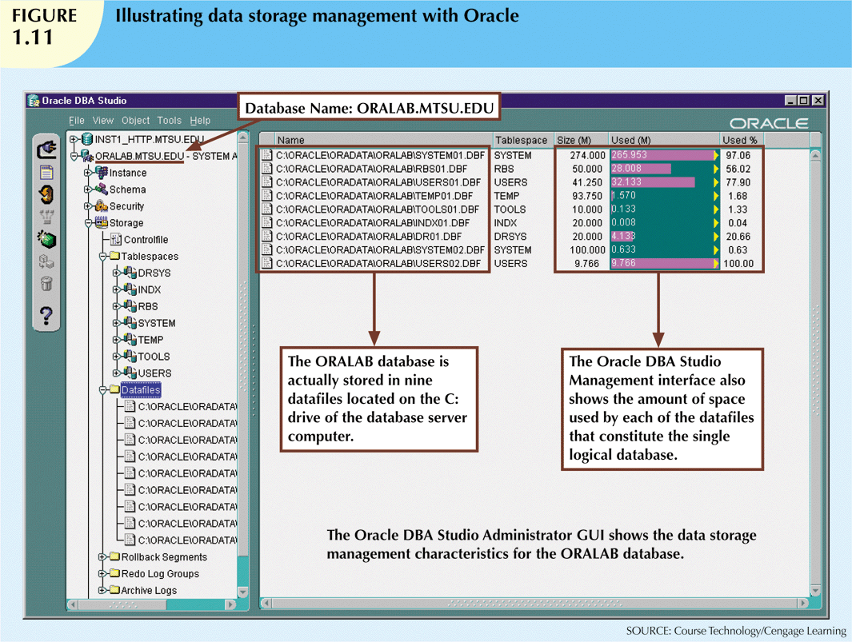

Slide 37
DBMS Functions (cont'd.)
Data transformation and presentation
  DBMS transforms data entered to conform to required data structures
  DBMS transforms physically retrieved data to conform to user’s logical expectations
Security management
  DBMS creates a security system that enforces user security and data privacy
  Security rules determine which users can access the database, which items can be accessed, etc.

Slide 38
DBMS Functions (cont'd.)
Multiuser access control
  DBMS uses sophisticated algorithms to ensure concurrent access does not affect integrity
Backup and recovery management
  DBMS provides backup and data recovery to ensure data safety and integrity
  Recovery management deals with recovery of database after a failure
    Critical to preserving database’s integrity

Slide 39
DBMS Functions (cont'd.)
Data integrity management
  DBMS promotes and enforces integrity rules
    Minimizes redundancy
    Maximizes consistency
  Data relationships stored in data dictionary used to enforce data integrity

Slide 40
DBMS Functions (cont'd.)
Database access languages and application programming interfaces
  DBMS provides access through a query language
  Structured Query Language (SQL) is the de facto query language
    Standard supported by majority of DBMS vendors

Slide 41
DBMS Functions (cont'd.)
Database communication interfaces
  Communications accomplished in several ways:
    End users generate answers to queries by filling in screen forms through Web browser
    DBMS automatically publishes predefined reports on a Web site
    DBMS connects to third-party systems to distribute information via e-mail

Slide 42
Disadvantages of database systems:
  Increased costs
  Management complexity
  Maintaining currency
  Vendor dependence
  Frequent upgrade/replacement cycles

Slide 43
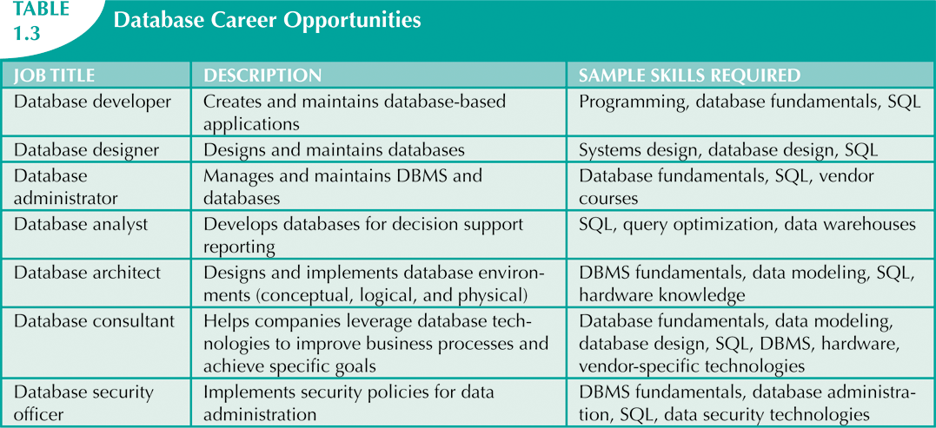
Preparing for Your Database Professional Career

Slide 44
Data Modeling and Data Models
Model: an abstraction of a real-world object or event
  Useful in understanding complexities of the real-world environment
Data models
  Relatively simple representations of complex real-world data structures
    Often graphical
A database model is a type of data model that determines the logical structure of a database and fundamentally determines in which manner data can be stored, organized and manipulated.

Slide 45
Data Model Basic Building Blocks
Entity: anything about which data are to be collected and stored
Attribute: a characteristic of an entity
Relationship: describes an association among entities
  One-to-many (1:M) relationship
  Many-to-many (M:N or M:M) relationship
  One-to-one (1:1) relationship
Constraint: a restriction placed on the data

Slide 46
Types of Data Models
Hierarchical model: here, each node or component has a child-parent relationship with one other node or component. It represents data as a hierarchical tree structure.
Network model: here, a single component can have multiple relationships.
Relational model: represents data as tables.
Object-oriented database model: represents data in the form of objects and classes.
We may describe a database with any one of these types depending on several factors; the biggest factor is whether the DBMS we are using supports a particular model.

Slide 47
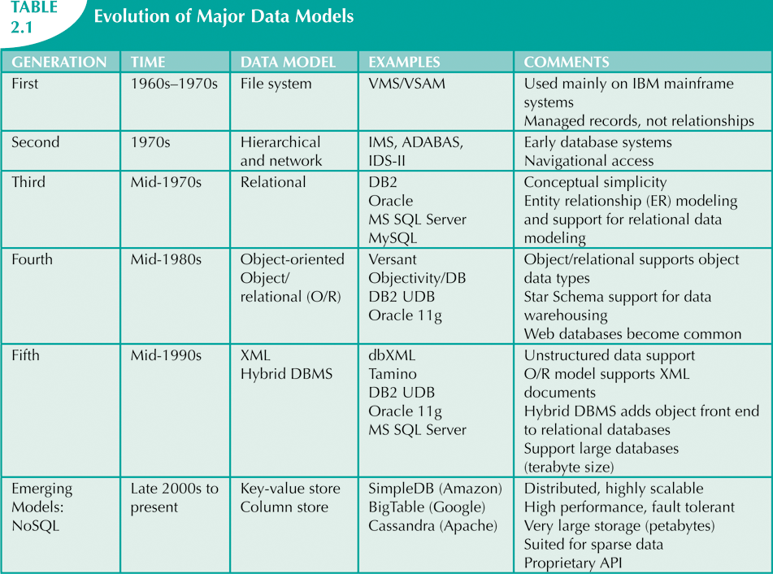
The Evolution of Data Models

Slide 48
Relational Data Model
- The dominant database model is the relational database model. All current major DBMS products are based on it.
  - The relational model was introduced in 1970 by IBM engineer E. F. Codd in his landmark paper “A Relational Model of Data for Large Shared Databanks” based on mathematical concept of a relation (Set theory).
  Set theory is a mathematical science that deals with sets, or groups of things, and is used as the basis for data manipulation in the relational model.
- Relational model represents the database as a collection of relations. A relation is nothing but a table of values

Slide 49
As mentioned, the foundation of relational databases is based on mathematical set theory. In a relational database, data is organized into tables, and each table can be seen as a set of tuples. Set operations such as union, intersection, and difference can be applied to these tables, allowing for powerful manipulation and retrieval of data. Additionally, relational algebra, which forms the basis of the query language SQL, is also based on Set theory concepts. Overall, Set theory provides the theoretical framework for understanding and working with relational databases.

